Slide 1

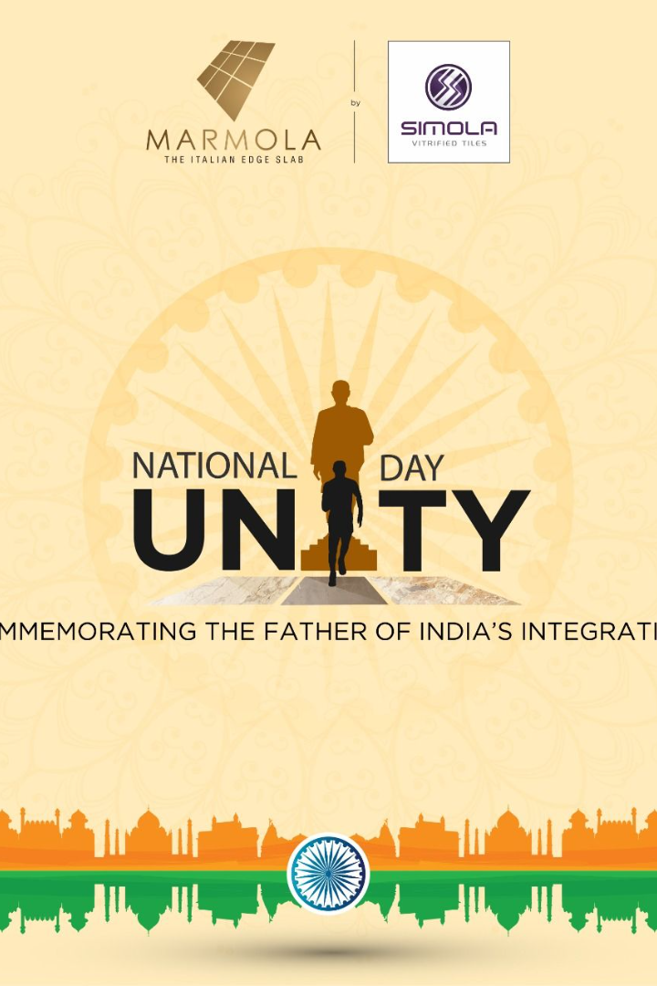

National Unity Day in India
Discover the significance of National Unity Day and explore the life and achievements of Sardar Vallabhbhai Patel in this captivating presentation.
by Baljinder Singh

Slide 2

What is National Unity Day?
1
A Day of Unity
National Unity Day, also known as Rashtriya Ekta Diwas, is celebrated in India to commemorate the birth anniversary of Sardar Vallabhbhai Patel.
2
Unifying India
It aims to promote unity, integrity, and security among the diverse regions and people of India.

Slide 3

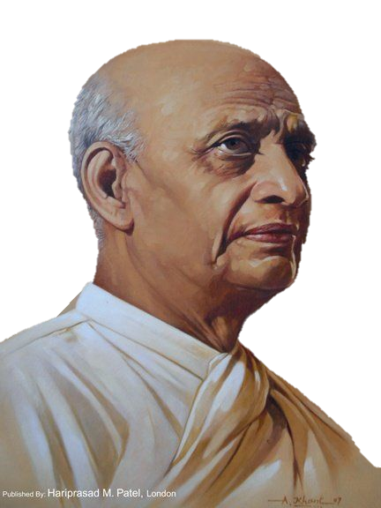
Birth of Sardar Vallabhbhai Patel
1
A Visionary Leader
Sardar Vallabhbhai Patel, born on October 31, 1875, was a prominent figure in the Indian independence movement.
2
Iron Man of India
Patel played a vital role in the unification of India through his relentless efforts and astute diplomacy.

Slide 4

Observance of National Unity Day
1
Nationwide Pledge
Millions of Indians take a pledge to dedicate themselves to preserving the unity and integrity of the nation.
Statue of Unity
2
The world's tallest statue, the 'Statue of Unity,' dedicated to Sardar Vallabhbhai Patel, is inaugurated on this day.
3
Cultural Programs
Various cultural programs and events are organized to celebrate the rich diversity of India and foster a sense of unity.

Slide 5
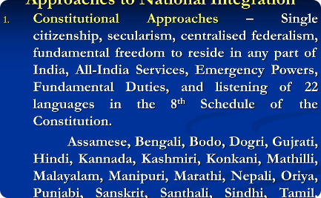
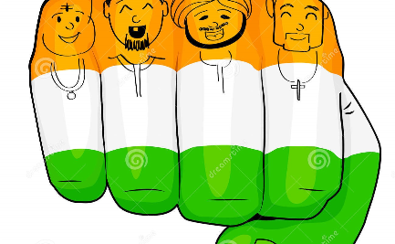

Promoting Unity and Integration
National Integration Programs
Unity in Diversity
Integration Campaigns
India's diversity is celebrated through festivals like 'Unity in Diversity Week,' showcasing the harmonious coexistence of different cultures and traditions.
Campaigns like 'Ek Bharat Shreshtha Bharat' focus on fostering unity by pairing states and promoting cultural exchange.
Several initiatives such as the National Integration Day and Cultural Integration Camps are conducted to strengthen the bond of unity among Indian citizens.

Slide 6

Importance of Unity in a Diverse Nation
1
Strength in Diversity
Unity is the cornerstone of India's progress, enabling it to harness the immense potential of its diverse population.
2
Resilience in Unity
Despite challenges, India has demonstrated remarkable resilience and solidarity, overcoming obstacles through unity.

Slide 7

Conclusion
1
Celebrate National Unity Day
Let us embrace the spirit of unity and take part in the celebrations of National Unity Day to uphold the values that Sardar Vallabhbhai Patel stood for.
2
Together We Thrive
By nurturing unity and integration, we can build a stronger, more prosperous India for future generations.

